Slide 1
Encoders and Decoders
Notes:
Give qualifications of instructors:
DAP
teaching computer architecture at Berkeley since 1977
Co-athor of textbook used in class
Best known for being one of pioneers of RISC
currently author of article on future of microprocessors in SciAm Sept 1995
RY
took 152 as student, TAed 152,instructor in 152
undergrad and grad work at Berkeley
joined NextGen to design fact 80x86 microprocessors
one of architects of UltraSPARC fastest SPARC mper shipping this Fall

Slide 2
Overview
Binary decoders
  Converts an n-bit code to a single active output
  Can be developed using AND/OR gates
  Can be used to implement logic circuits.
Binary encoders
  Converts one of 2^{n} inputs to an n-bit output
  Useful for compressing data
  Can be developed using AND/OR gates
Both encoders and decoders are extensively used in digital systems
Notes:
credential:
bring a computer
die photo
wafer
:
This can be an hidden slide. I just want to use this to do my own planning.
I have rearranged Culler’s lecture slides slightly and add more slides. This covers everything he covers in his first lecture (and more) but may
We will save the fun part, “ Levels of Organization,” at the end (so student can stay awake): I will show the internal stricture of the SS10/20.
Notes to Patterson: You may want to edit the slides in your section or add extra slides to taylor your needs.

Slide 3
Binary Decoder
Black box with n input lines and 2^{n} output lines
Only one output is a 1 for any given input
Binary
Decoder
n
inputs
2^{n} outputs

Slide 4
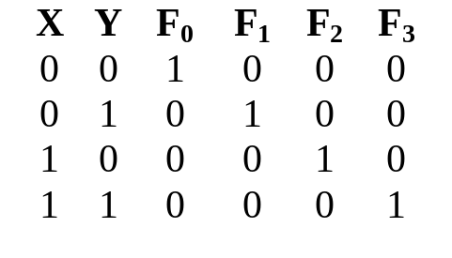
2-to-4 Binary Decoder
Truth Table:
F₀ = X'Y'
F₁ = X'Y
From truth table, circuit for 2x4 decoder is:
Note: Each output is a 2-variable minterm (X'Y', X'Y, XY' or XY)
F₂ = XY'
F₃ = XY
F0
F1
F2
F3
X
Y
X
2-to-4
Decoder
Y

Slide 5
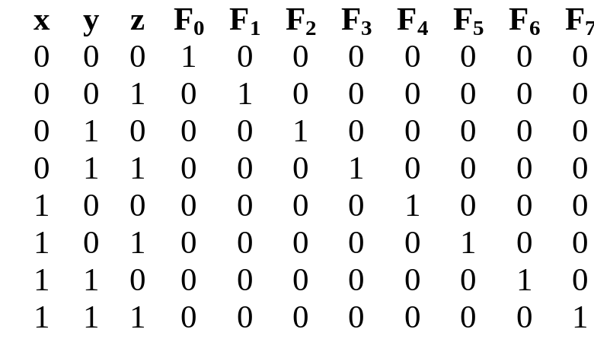
3-to-8 Binary Decoder
Truth Table:
F₀ = x'y'z'
F₁ = x'y'z
F₂ = x'yz'
F₃ = x'yz
F₄ = xy'z'
F₅ = xy'z
F₆ = xyz'
F0
F1
F2
F3
F4
F5
F6
F7
F₇ = xyz
X
3-to-8
Decoder
Y
Z
x
y
z

Slide 6
Implementing Functions Using Decoders
Any n-variable logic function can be implemented using a single n-to-2^{n} decoder to generate the minterms
  OR gate forms the sum.
  The output lines of the decoder corresponding to the minterms of the function are used as inputs to the or gate.
Any combinational circuit with n inputs and m outputs can be implemented with an n-to-2^{n} decoder with m OR gates.
Suitable when a circuit has many outputs, and each output function is expressed with few minterms.

Slide 7
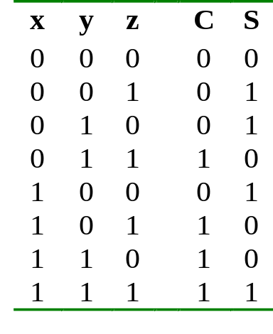
Implementing Functions Using Decoders
Example: Full adder
  S(x, y, z) = Σ (1,2,4,7)
  C(x, y, z) = Σ (3,5,6,7)
3-to-8
Decoder
0
1
2
3
4
5
6
7
S
x
S₂
S₁
S₀
y
z
C

Slide 8
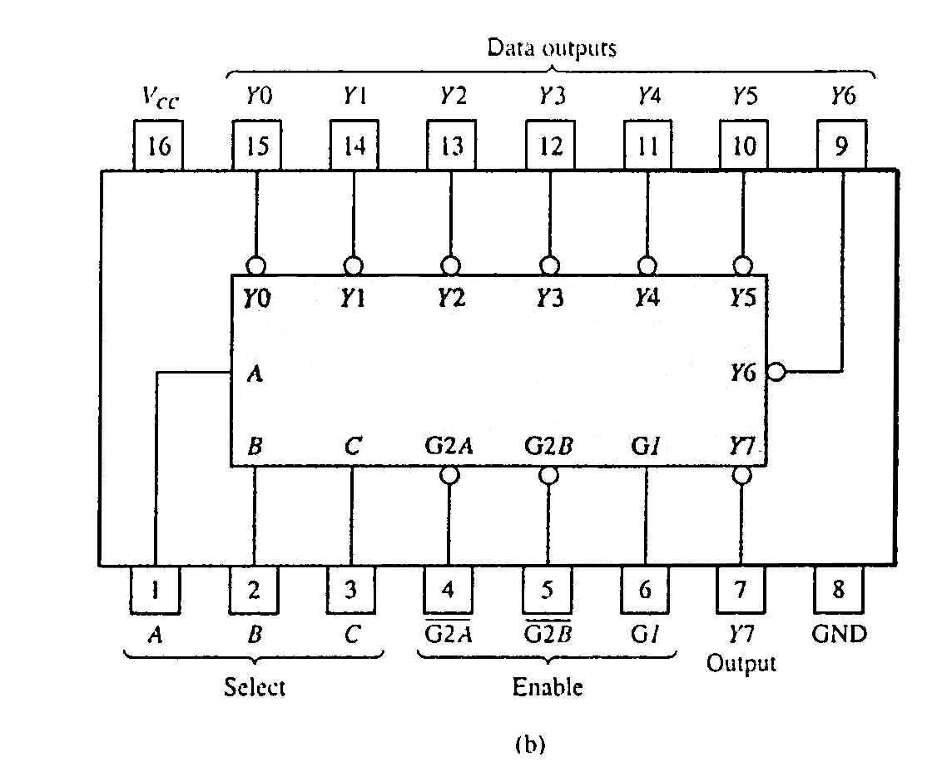
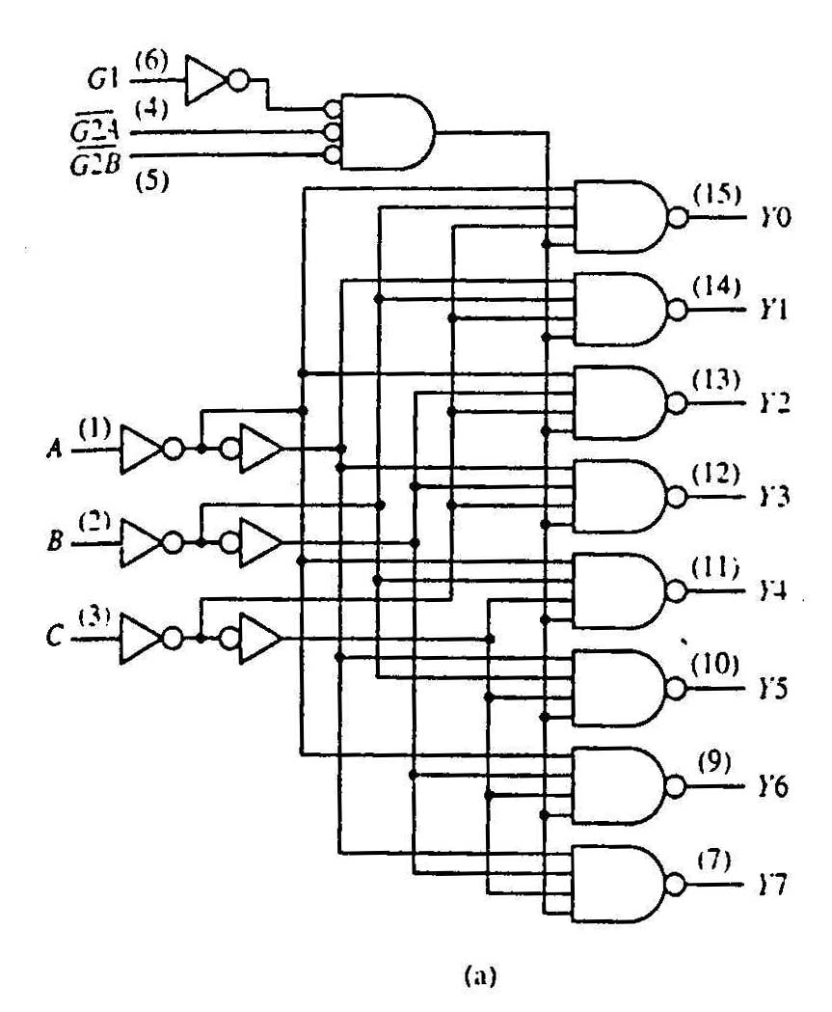
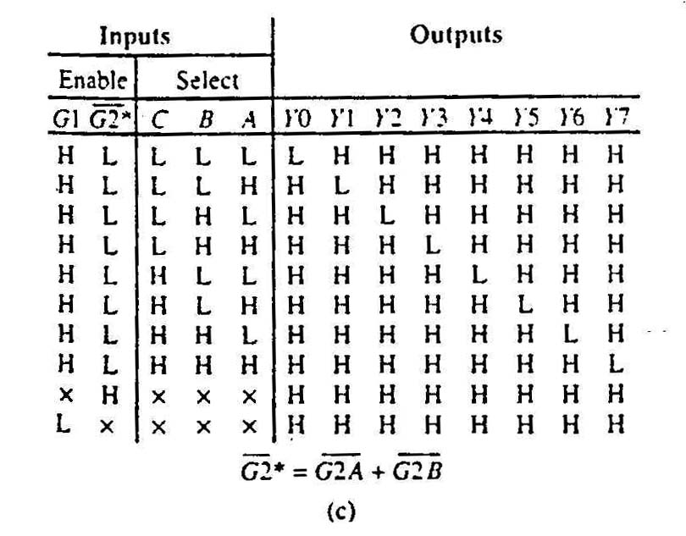
Standard MSI Binary Decoders Example
74138 (3-to-8 decoder)
(a) Logic circuit.
(b) Package pin configuration.
(c) Function table.

Slide 9
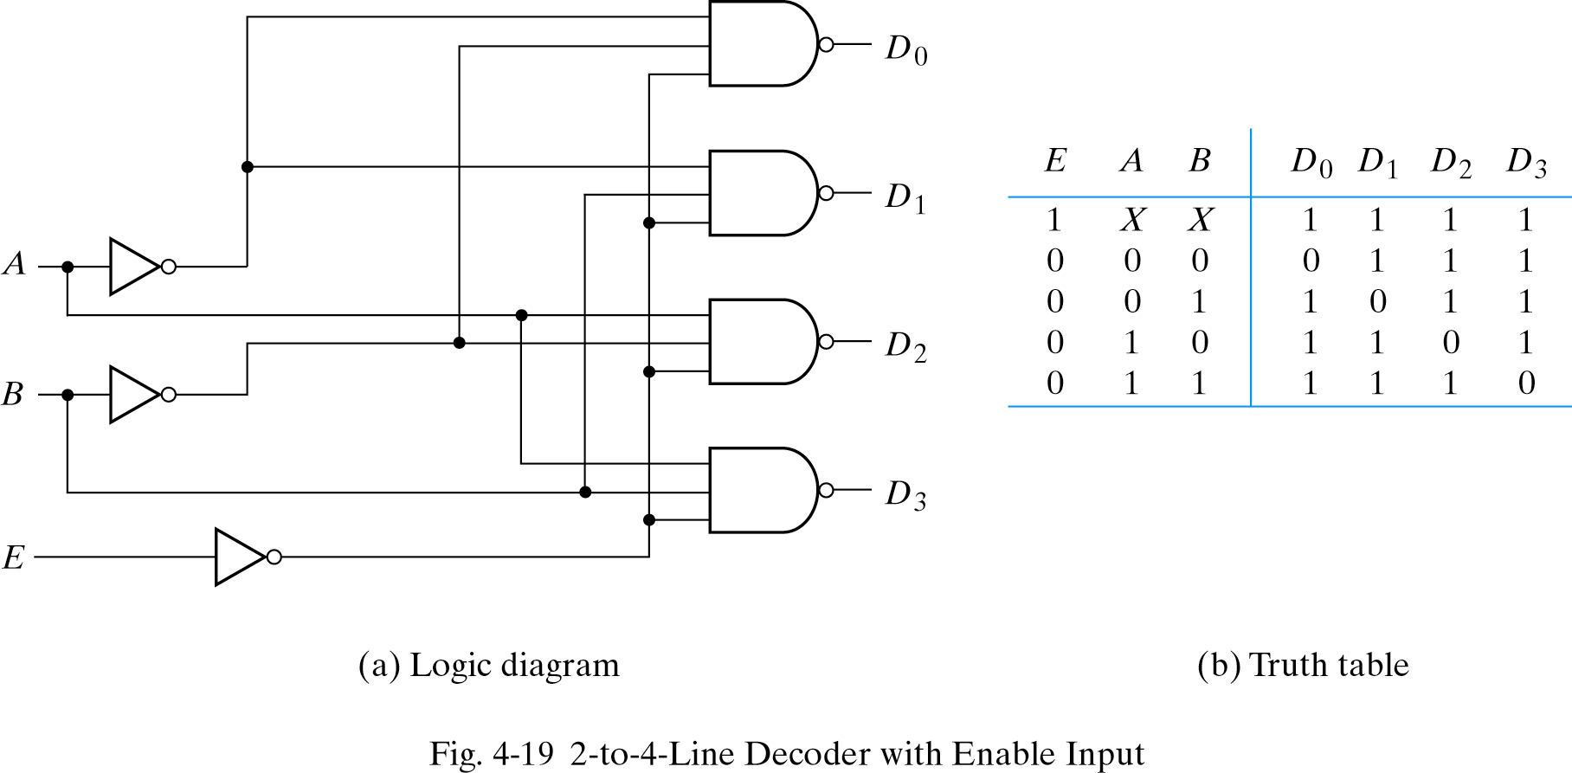
Building a Binary Decoder with NAND Gates
Start with a 2-bit decoder
  Add an enable signal (E)
Note: use of NANDs
only one 0 active!
if E = 0

Slide 10
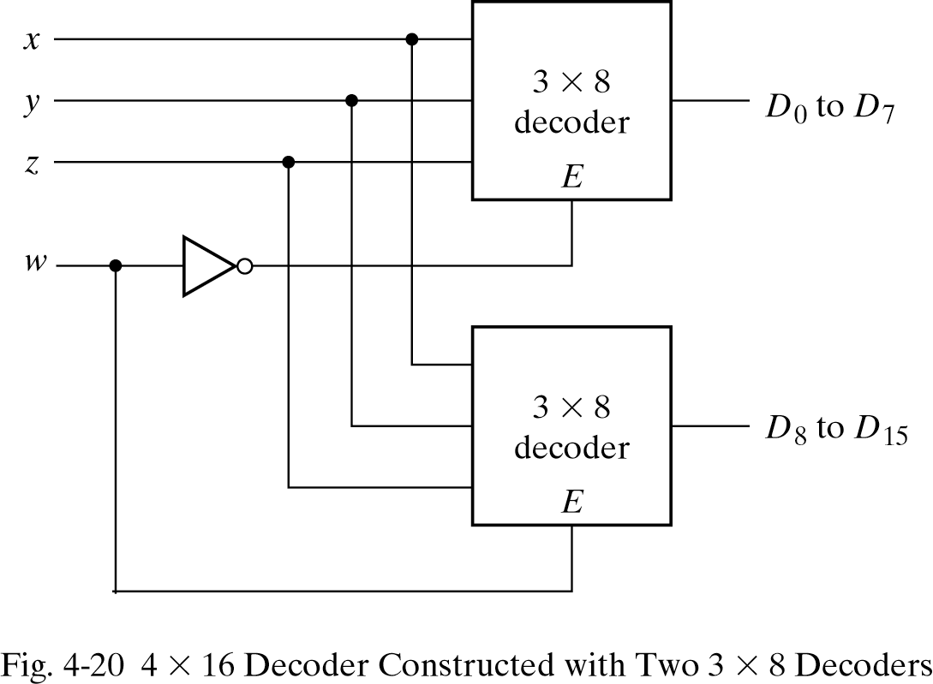
Use two 3 to 8 decoders to make 4 to 16 decoder
Enable can also be active high
In this example, only one decoder can be active at a time.
x, y, z effectively select output line for w

Slide 11
Encoders
If the a decoder's output code has fewer bits than the input code, the device is usually called an encoder.
e.g. 2^{n}-to-n
The simplest encoder is a 2^{n}-to-n binary encoder
  One of 2^{n} inputs = 1
  Output is an n-bit binary number
Binary
encoder
2^{n}
inputs
n
outputs
.
.
.
.
.
.

Slide 12
8-to-3 Binary Encoder
At any one time, only
one input line has a value of 1.
Inputs
Outputs
I
0
I
1
I
2
I
3
I
4
I
5
I
6
I
7
y₂
y₁
y₀
1
0
0
0
0
0
0
0
0
0
0
0
1
0
0
0
0
0
0
0
0
1
0
0
1
0
0
0
0
0
0
1
0
0
0
0
1
0
0
0
0
0
1
1
0
0
0
0
1
0
0
0
1
0
0
0
0
0
0
0
1
0
0
1
0
1
0
0
0
0
0
0
1
0
1
1
0
0
0
0
0
0
0
0
1
1
1
1
I₀
I₁
I₂
I₃
I₄
I₅
I₆
I₇
y₂ = I₄ + I₅ + I₆ + I₇
y₁ = I₂ + I₃ + I₆ + I₇
y₀ = I₁ + I₃ + I₅ + I₇

Slide 13
8-to-3 Priority Encoder
What if more than one input line has a value of 1?
Ignore “lower priority” inputs.
Idle indicates that no input is a 1.
Note that polarity of Idle is opposite from Table 4-8 in Mano
Inputs
Outputs
I
0
I
1
I
2
I
3
I
4
I
5
I
6
I
7
y₂
y₁
y₀ Idle
0
0
0
0
0
0
0
0
x
x
x 1
1
0
0
0
0
0
0
0
0
0
0 0
X
1
0
0
0
0
0
0
0
0
1 0
X
X
1
0
0
0
0
0
0
1
0 0
X
X
X
1
0
0
0
0
0
1
1 0
X
X
X
X
1
0
0
0
1
0
0 0
X
X
X
X
X
1
0
0
1
0
1 0
X
X
X
X
X
X
1
0
1
1
0 0
X
X
X
X
X
X
X
1
1
1
1 0

Slide 14
Priority Encoder (8 to 3 encoder)
Assign priorities to the inputs
When more than one input are asserted, the output generates the code of the input with the highest priority
Priority Encoder :
H7=I7 (Highest Priority)
H6=I6.I7’
H5=I5.I6’.I7’
H4=I4.I5’.I6’.I7’
H3=I3.I4’.I5’.I6’.I7’
H2=I2.I3’.I4’.I5’.I6’.I7’
H1=I1. I2’.I3’.I4’.I5’.I6’.I7’
H0=I0.I1’. I2’.I3’.I4’.I5’.I6’.I7’
IDLE= I0’.I1’. I2’.I3’.I4’.I5’.I6’.I7’
Encoder
Y0 = I1 + I3 + I5 + I7
Y1 = I2 + I3 + I6 + I7
Y2 = I4 + I5 + I6 + I7
Priority encoder
Priority Circuit
Binary encoder
I0
I0
H0
I0
I1
I1
H1
I1
I2
I2
H2
I2
Y0
Y0
I3
I3
H3
I3
Y1
Y1
I4
I4
H4
I4
Y2
Y2
I5
I5
H5
I5
I6
I6
H6
I6
I7
I7
H7
I7
IDLE
IDLE

Slide 15
Encoder Application (Monitoring Unit)
Encoder identifies the requester and encodes the value
Controller accepts digital inputs.
Alarm Signal
Contoller Response
Machine 1
Machine 2
Machine
Code
Action
Encoder
Controller
Machine n

Slide 16
Summary
Decoder allows for generation of a single binary output from an input binary code
  For an n-input binary decoder there are 2^{n} outputs
Decoders are widely used in storage devices (e.g. memories)
  We will discuss these in a few weeks
Encoders all for data compression
Priority encoders rank inputs and encode the highest priority input
Next time: storage elements!
Notes:
credential:
bring a computer
die photo
wafer
:
This can be an hidden slide. I just want to use this to do my own planning.
I have rearranged Culler’s lecture slides slightly and add more slides. This covers everything he covers in his first lecture (and more) but may
We will save the fun part, “ Levels of Organization,” at the end (so student can stay awake): I will show the internal stricture of the SS10/20.
Notes to Patterson: You may want to edit the slides in your section or add extra slides to taylor your needs.

